Slide 1


Hearing Conservation Overview
Tri-Service Hearing Technician
4.2 Certification Course

Slide 2
Hearing Conservation Overview
Learning Objectives
1.2.1 Describe the effects of exposure to hazardous noise
1.2.2 Describe the purposes of the Hearing Conservation Program (HCP)
1.2.3 Describe the elements of the Hearing Conservation Program (HCP)
1.2.4 Identify the team members of the Hearing Conservation Program (HCP)
1.2.5 Identify the four “P”s of a noise-induced hearing loss
1.2.6 Identify and explain the role of the Occupational Hearing Conservationist (OHC) also known as hearing technician
1.2.7 Understand a change in hearing - Significant/Standard Threshold Shift (STS), Early Warning Shift (EWS)
1.2.8 Understand what normal hearing is
Tri-Service Hearing Technician 4.2 Certification Course

Slide 3
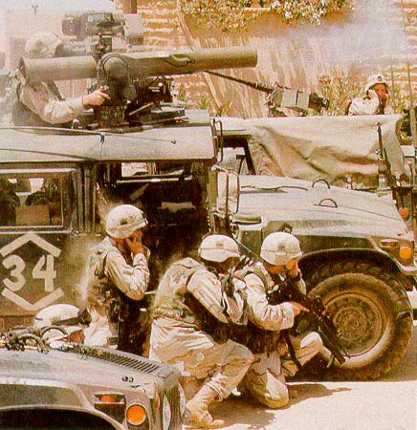
Hearing Conservation Overview
Impact of Hearing Loss
Noise-Induced Hearing Loss (NIHL)
#1 occupational health hazard in the military
Tri-Service Hearing Technician 4.2 Certification Course
Notes:
Good hearing equates to: Less safety mishaps, injuries and deaths; more lethal/effective service members; increased mission readiness
Noise in the military: Largest occupational health hazard; Noise-induced hearing injuries/illness; Sources of noise on/off duty; Noise in the civilian workforce
1. Noise-Induced Hearing Loss is the #1 occupational health hazard in the military (Veterans Administration Benefits Report 2010 through 2016).
Sudden HL due to “sudden” explosions
Gradual progressive HL due to continuous exposure to noise over time
2. NIHL negatively affects
Combat and mission readiness; Fitness for Duty; Retention for job specialty (job qualifications); Quality of life
3. Loss of communication ability, difficulty understanding conversations
Combination effects of noise and aging; Hearing aids may help, but don’t cure; Ringing in the ears/tinnitus

Slide 4
Hearing Conservation Overview
Noise in the Military
Exposure to hazardous noise, without hearing protection (unprotected) can cause:
  Temporary and/or permanent hearing loss
  Temporary and/or permanent tinnitus
Noise-induced ailment (hearing loss/tinnitus)
  Occur gradually over time from repeated exposures
Noise-induced injury (hearing loss/tinnitus)
  Occur from one significant exposure/event
Tri-Service Hearing Technician 4.2 Certification Course

Slide 5
Hearing Conservation Overview
Noise Sources
Occupational (DoD)
  Machinery, weapons, vehicles, tools, equipment
Occupational (Civilian)
  Industrial machinery, constructive equipment, explosives, farming equipment, musical instruments, railroads
  Manufacturing - 14% of the workforce but has 80% of the incidence of the noise-induced hearing loss
Non-occupational
  Lawn care, power tools/equipment, firearms, music, motorcycle, air pods/ear buds
Tri-Service Hearing Technician 4.2 Certification Course
Notes:
Sources of noise can be related to military/DoD work, as well as recreational off-duty exposures.
Other common sources of occupational noise outside of DoD including agriculture, mining and railroad industries, as well as manufacturing. (Important for CAOHC testing)

Slide 6
Hearing Conservation Overview
Auditory Effects of Noise Exposure
Loss of hearing sensitivity
Tinnitus or “ringing”
Missing parts of conversation
Slower/Inaccurate localization
Increased errors, safety mishaps
Tri-Service Hearing Technician 4.2 Certification Course
Notes:
Auditory Effects of Hazardous Noise Exposure:
Loss or impairment of hearing sensitivity/communication ability/localization
Tinnitus
Increased errors/safety mishaps; auditory situational awareness
Hearing loss affects our ability to understand speech; affects our social communication and possibly a person’s comfort in social situations
Tinnitus or “ringing” is generally associated with hearing loss and will likely be constant and permanent
Hearing loss causes a person to miss parts of a conversation – this can lead to multiple requests for the speaker to repeat, or responding inappropriately because the person guessed incorrectly
Hearing loss will affect how quickly and accurately you are able to localize where sounds originate
Hearing loss increases the chance of errors and safety mishaps

Slide 7
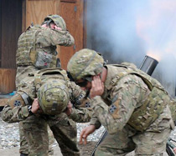
Hearing Conservation Overview
Non-Auditory Effects of Noise Exposure
Health risks - exposure to hazardous noise may:
  Raise blood pressure
  Raise heart rate
  Increase stress hormone levels
  Disrupt healthy sleep patterns
  Possible reassignment to different MOS/AFSC/NEC/SDOC (job)
  Embarrassment, frustration, withdrawal
Noise
gets
on
our
NERVES!
Tri-Service Hearing Technician 4.2 Certification Course Video Next Slide
Notes:
Non-Auditory Effects of Noise: Increased blood pressure/heart rate; stress, fatigue, irritability; social and communication concerns
Noise not only can cause hearing loss but other health problems too; Raises blood pressure; Raises heart rate; Increases stress hormone levels; Disrupts healthy sleep patterns
These auditory effects often result in embarrassment and frustration, which then can lead to the individual withdrawing from the social communication of a work team
The inability to hear accurately and consistently may lead to job or MOS/AFSC reassignment
(Image: Photo: VA Public Health, Noise Exposure https://www.publichealth.va.gov/exposures/noise/index.asp)

Slide 8
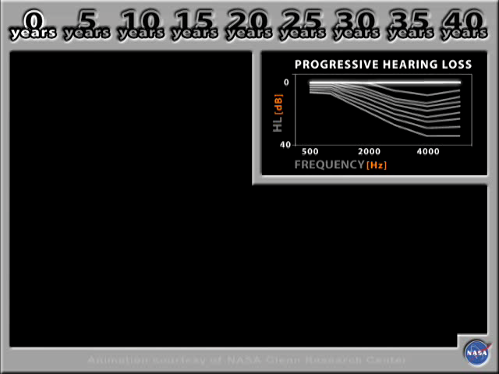
Notes:
1 minute Hearing Loss Demonstration Video – have students pay attention to the year scale and progressive hearing loss graph
Musical selection is filtered to simulate 40 years of progressive noise-induced hearing loss in 5-year increments, with each 5-year increment indicated by a “beep.”
At the end of the selection, the filtering is removed.
Linked animated video demonstration file: music rock (0:59)
Musical content on tracks 5 and 12 to 21 is licensed from the respective copyright owners. All Rights Reserved. Unauthorized duplication is a violation of applicable laws.

Slide 9
Hearing Conservation Overview
The 4 P’s of a Noise-Induced Hearing Loss (NIHL)
Painless
Progressive
Permanent
Preventable
Tri-Service Hearing Technician 4.2 Certification Course

Slide 10
Hearing Conservation Overview
Brief History of Hearing Conservation
1970 - Congress enacts the Occupational Safety and Health Act
Established Occupational Safety and Health Administration (OSHA - regulatory agency)
  Regulates most US industry
  Not science-based
Established the National Institute for Occupational Safety and Health (NIOSH - best practices, education and research)
  Government agency, part of HHS Centers for Disease Control and Prevention (CDC)
  Responsible for conducting research and making recommendations for the prevention of work-related illnesses and injuries (best practices)
  Produces and distributes free documents, products, and services related to hearing conservation
  Evidence/Science-based
Tri-Service Hearing Technician 4.2 Certification Course
Notes:
The first civilian noise standard was issued by the U.S. Department of Labor in 1969 under the 1936 authority of the Walsh-Healey Act. By passing the Walsh-Healy Noise Standard Act, Congress gave the Department of Labor authority to regulate companies with contracts with the Federal Government. In 1970, Congress enacted the Occupational Safety and Health Act. The act created OHSA in the Department of Labor as well as the National Institute for Occupational Safety and Health (NIOSH) in the U.S. Department of Health, Education, and Welfare; currently located at the Department of Health and Human Services. NIOSH currently resides within the Department of Health and Human Services. When it comes to federal regulations, OSHA is generally cited as the basis for all, but federal agencies such as the Mine Safety and Health Administration, the U.S. Department of Defense, and the Federal Railroad Administration also have governing mandates.
(CAOHC Hearing Conservation Manual pp. 35)

Slide 11
Hearing Conservation Overview
Purpose of the Hearing Conservation Program (HCP)
Prevent occupationally related NIHL
Maintain combat readiness
Maintain fitness for duty
Retain job or work specialty
Reduce cost of hearing loss
Promote healthy hearing & quality of life
Tri-Service Hearing Technician 4.2.0.0 Certification Course

Slide 12
Hearing Conservation Overview
HCP Major Elements
Noise Hazard Assessment
Noise Controls
Audiometric Monitoring
Hearing Protection Devices (HPDs)
Hearing Conservation Education
Recordkeeping
Program Evaluation
Tri-Service Hearing Technician 4.2 Certification Course
Notes:
29 CFR 1910.95 Occupational Safety and Health Administration, Dept. of Labor

Slide 13
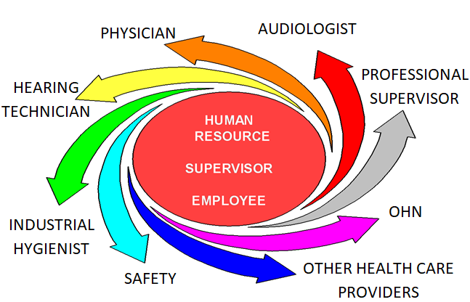
Hearing Conservation Overview
HCP Team Members
Tri-Service Hearing Technician 4.2 Certification Course
Notes:
OHC Team involves personnel at all levels of command; all team members are essential
To carry out OSHA/DOD/Service-level instructions for the HCP
To maintain Readiness
To ensure Quality of Life
Team members may include:
Noise Professionals: Industrial Hygienist, Bio-environmental Engineers
Audiologist
Occupational Health Nurse
Occupational Medicine Physician/Flight Medicine Physician
Public Health
Safety Officer
Occupational Hearing Conservationist
Other personnel (Commanders, Workers, Supervisors, etc.)

Slide 14
Hearing Conservation Overview
Occupational Hearing Conservationist (Hearing Technician)
Critical role in achieving goals/purpose of the HCP
  Maintain current DoD Hearing Technician Certification
  Equipment preparation/maintenance
  DOEHRS-HC Data Entry (verifying and modifying patient demographic data in conjunction with audio test selection)
  Recordkeeping
  Tests all personnel
  Stock and Fit Hearing Protective Device (HPD)
Tri-Service Hearing Technician 4.2.0.0 Certification Course

Slide 15
Hearing Conservation Overview
Occupational Hearing Conservationist (Hearing Technician)
Critical role in achieving goals/purpose of the HCP
  Educate (counseling on test results)/Motivates patients to take care of their hearing
    Is there a change in hearing?
    Is hearing in the range of normal?
    Does the patient need to return for follow-up testing or referred elsewhere?
  Answer patient questions
  Process referrals to the correct echelon of care
Tri-Service Hearing Technician 4.2.0.0 Certification Course
Notes:
This slide coincides with the following slide

Slide 16
Hearing Conservation Overview
Definitions
Normal Hearing
  Audiometric threshold results that range from (Negative) -10 to 25 dB
Threshold of hearing
  The lowest level of sound a person can hear in a series of ascending, pure tone presentation trials at least 50% of the time
Early Warning Shift (EWS)
  A difference of > 15 dB (positive) at 1000 Hz, 2000 Hz, 3000 Hz or 4000 Hz, relative to the reference audiogram, in either ear, without an STS
  If an STS is present in the same ear, the STS takes precedence
Tri-Service Hearing Technician 4.2.0.0 Certification Course
Notes:
Review above briefly, this will assist if future slides for counseling purposes. All STS/EWS require patient signature on the DD Form 2216

Slide 17
Hearing Conservation Overview
Definitions
Significant/Standard Threshold Shift (STS)
  An average change of plus or minus 10 dB at 2000 Hz, 3000 Hz, and 4000 Hz, relative to the reference audiogram, in either ear, without age corrections (DoDI 6055.12)
Temporary Threshold Shift (TTS)
  An STS that resolves on follow-up test after auditory rest (≥14 hours)
Permanent Threshold Shift (PTS)
  An STS that doesn’t resolve on follow-up testing after auditory rest (≥14 hours)
  Validated by an audiologist, otolaryngologist or physician (Professional Supervisor)
Tri-Service Hearing Technician 4.2.0.0 Certification Course
Notes:
Review above briefly, this will assist if future slides for counseling purposes. All STS/EWS require patient signature on the DD Form 2216

Slide 18
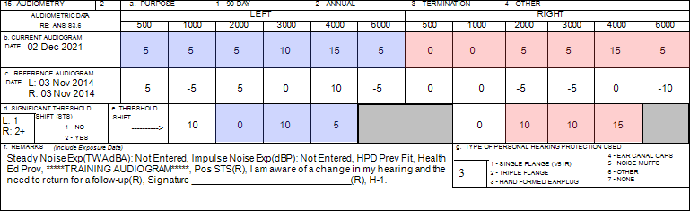
[SSN = 990990018] Confirm demographic fields 2 thru 14 (page 6)
Is there a change in hearing (ear specific)?
Are thresholds within the range of normal (ear specific)?
Where does the patient need to go?
Tri-Service Hearing Technician 4.2.0.0 Certification Course
Notes:
Do a brief review of counseling; have patient confirm their data in demographic fields 2 thru 14.
Is there a change in hearing?
Are thresholds within the range of normal?
Where does the patient need to go?
Have students write responses in their training booklet

Slide 19
Role of the Council for Accreditation in Occupational Hearing Conservation (CAOHC)
Provide consistent training for Occupational Hearing Conservationist (OHC), Course Directors (CD), and Professional Supervisors (PS)
Promote the establishment of best practices in HCP
Provide certification of Occupational Hearing Conservationist (OHC) and Professional Supervisor (PS)
Tri-Service Hearing Technician 4.2.0.0 Certification Course
Notes:
Explain what a PS is.

Slide 20
Hearing Conservation Overview
Summary
Hazardous noise
  Impact of hearing loss
  Noise in the military
  Auditory and non-auditory effects of noise
  Noise-induced hearing loss characteristics
Hearing Conservation Program
  Purpose/Elements/Team members
4 P’s of a noise-induced hearing loss
Change in hearing - Significant/Standard Threshold Shift (STS)
Early Warning Shift (EWS)
Normal Hearing Thresholds
Tri-Service Hearing Technician 4.2.0.0 Certification Course

Slide 21
Hearing Conservation Overview
? Questions ?
Tri-Service Hearing Technician
4.2 Certification Course

